Slide 1

Predict the Right Price Range of a Mobile Phone
Data Capstone: Preliminary Results
Zhen Zhang

Slide 2

Introduction
Data Overview
Exploratory Data Analysis and Feature Engineering:
Statistics Analysis
Data Engineer”
Check Missing Value
Delete Some Variable
Encoding
Univariate Variable and Pair Variable Analysis
Models:
Data Pre-processing
Machine Learning Part:
Naïve Bayes
Support Vector Machine (SVM)
Decision
Neural Network: Multilayer Perceptron (MLP)
Models Comparison and Selected
Conclusion

Slide 3
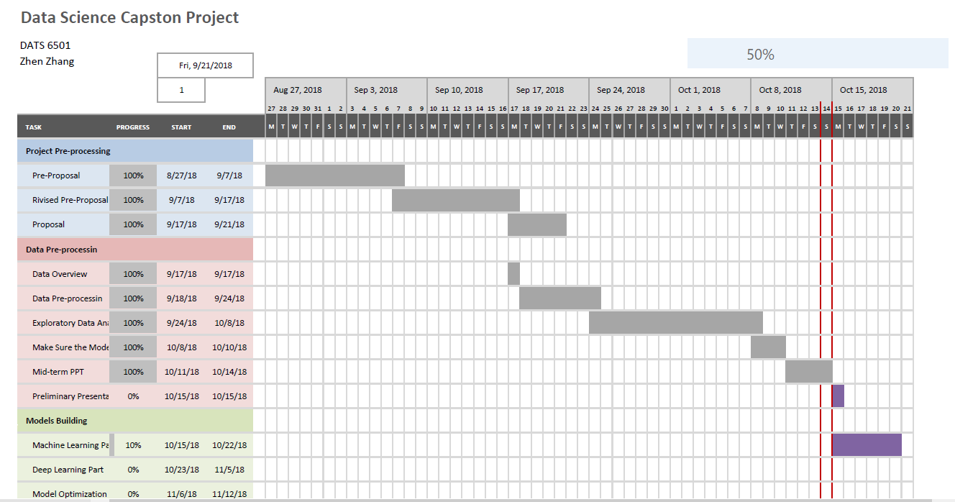
Gantt Chart

Slide 4

Dataset Introduction and Limitation
The datasets were taken from Kaggle. There are two datasets, one is “train.csv” (2000 rows and 21 columns), another is “test.csv” (1000 rows and 21 columns ).
The initial database contains 21 features of mobile phone of varies companies.
The limitation of this dataset is the dataset just provide us the price range of mobile phone instead of specific price of phone.

Slide 5
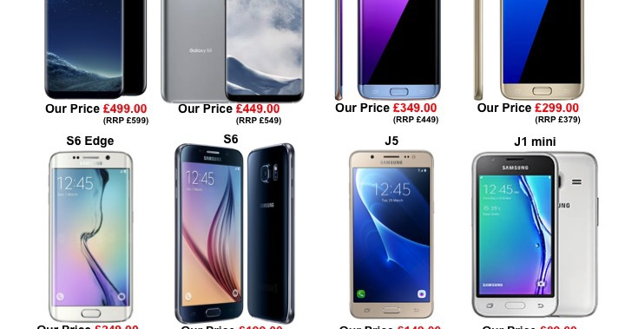
Problem Definition
Find out the relation between features of mobile phone and find out which feature are most related to the price range of mobile phone.
Using the machine learning technique to predict the right price range of a mobile phone in the competitive mobile phone market.

Slide 6
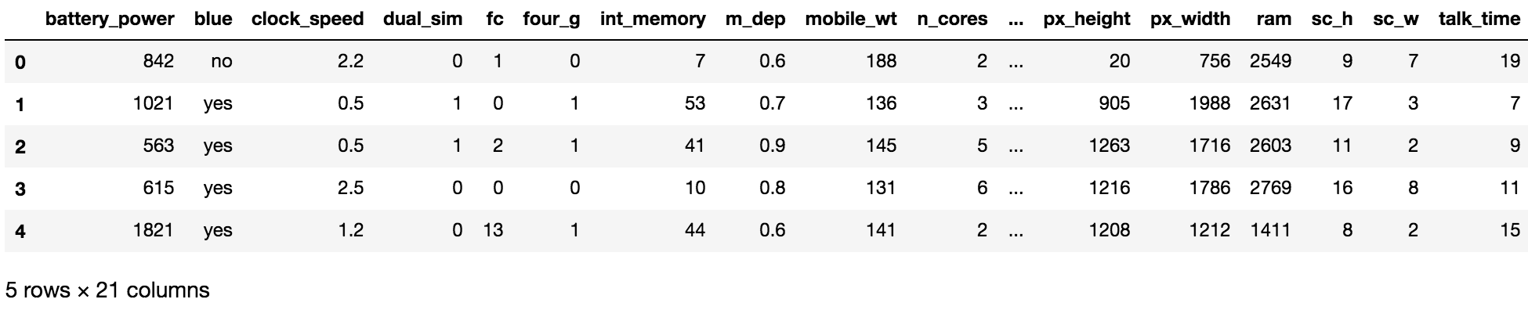
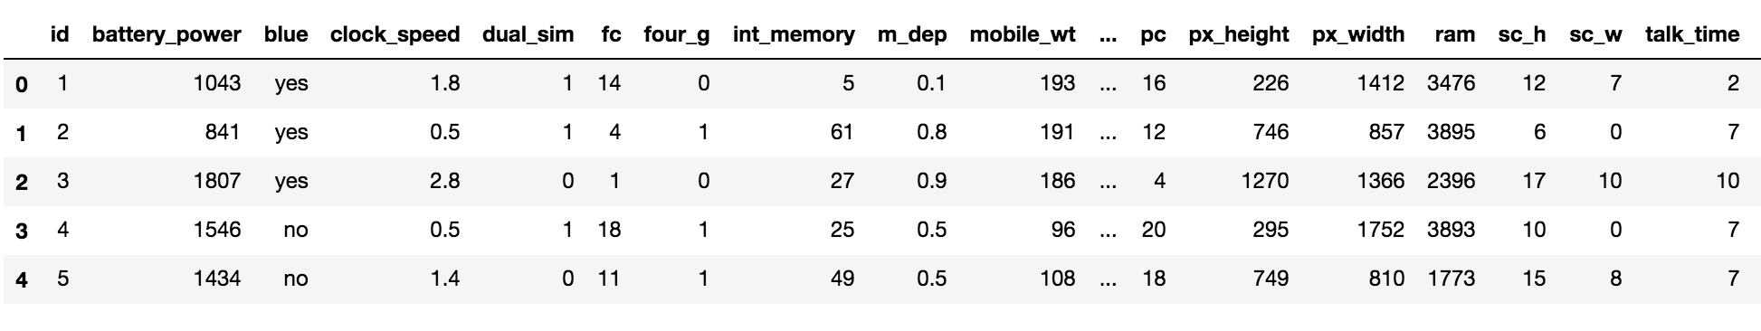
Data Overview

Slide 7

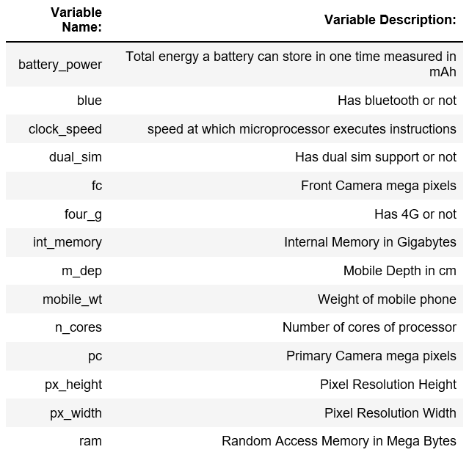
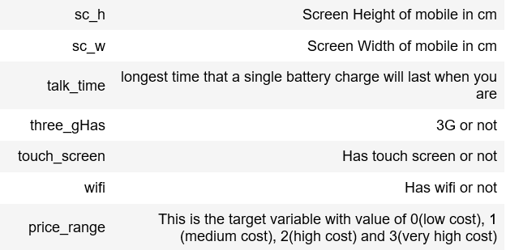
Data Dictionary

Slide 8
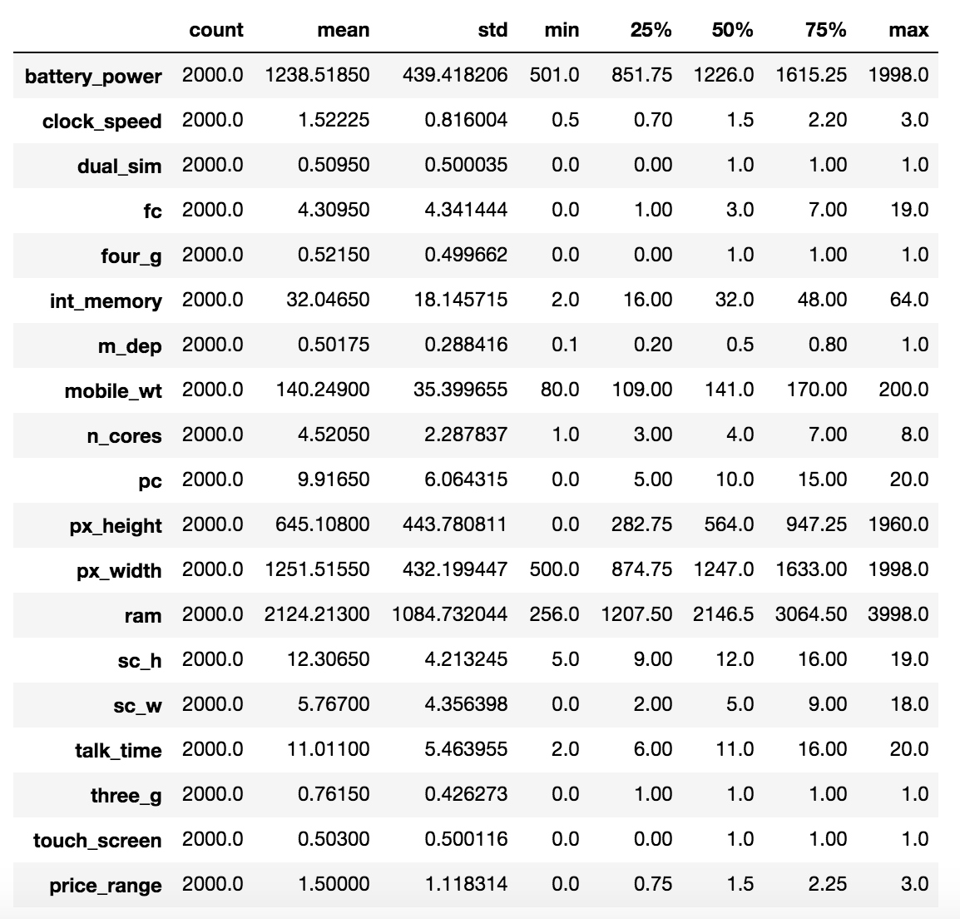
Initial Data Analysis

Slide 9
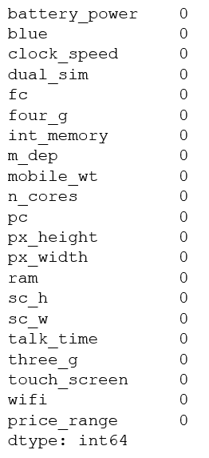
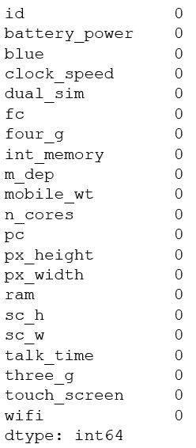
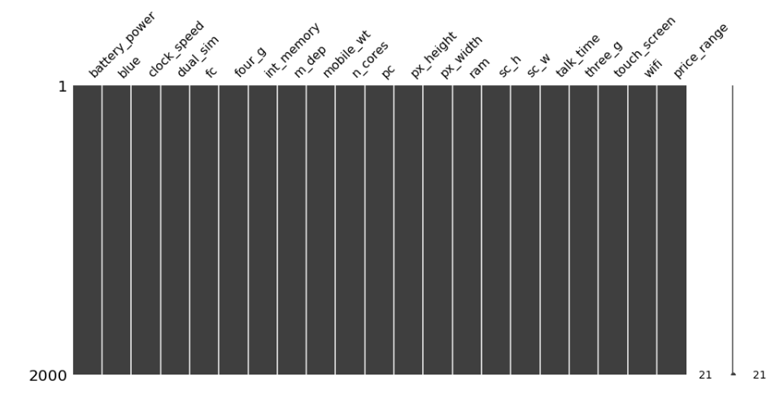
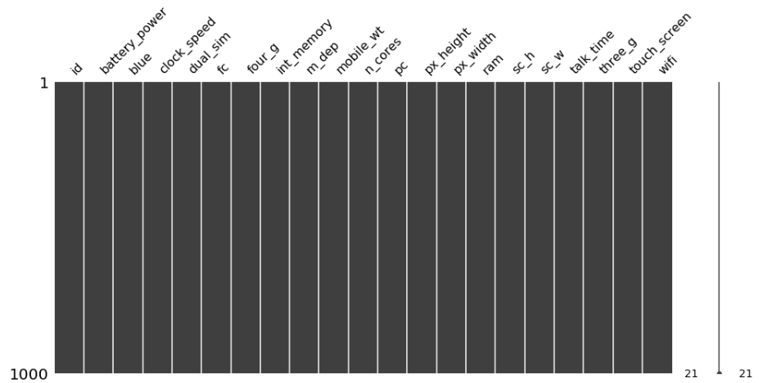
Exploratory Data Analysis and Feature Engineering -Check Missing Value
isnull()
isnull()
msno.matrix
msno.matrix
Notes:
I used the ‘msno.matrix’ function to build a nullity matrix to visualize the patterns of missing values

Slide 10
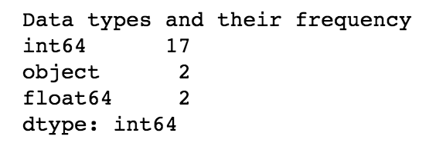
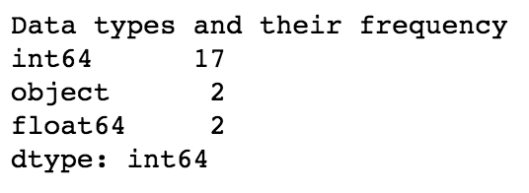
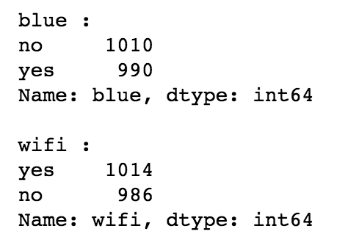
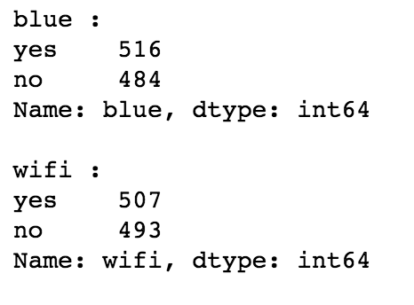
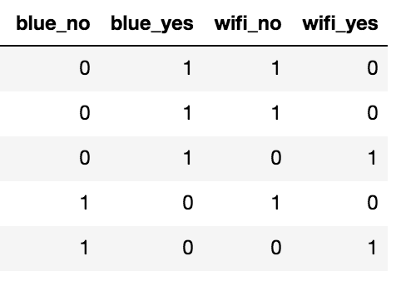
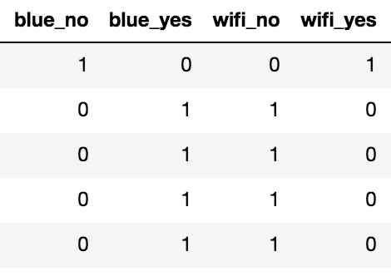
Handle with Categorial Variable
pandas.get_dummies( )
Notes:
Dtype (numpy) and value count function-find out the number of columns that are "object" in training set
Dtype function
get format for value of each object column for training set
# Since the value of our obeject columns are the nominal values, pandas.get_dummiesI encode them as dummy variables

Slide 11
Narrow Down Columns-Delete Columns 1. Random Forest Classifier-Check Unimportant Variable
1. There are no useless columns
2. "ram" and "battery_power" are most important to the price range
Notes:
# Train the Random Forest model for raw data
# to check whether there have the useless columns or not
After built the random forest model, I computed the importance for each feature

Slide 12
Correlation Coefficient-Check Correlated Dependent Features
Drop “fc”

Slide 13
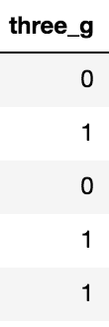
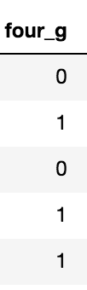
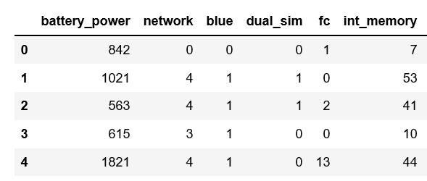
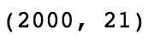
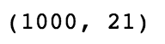
Data Engineering- Encoding
4G: 4
3G: 3
Neither 4G Nor 3G: 0

Slide 14
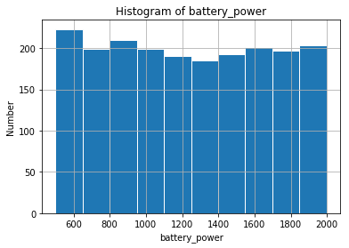
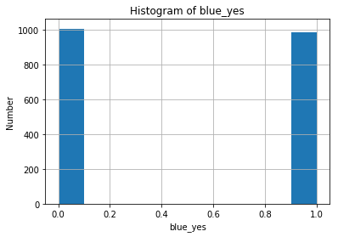
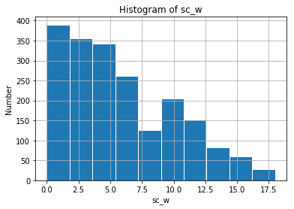
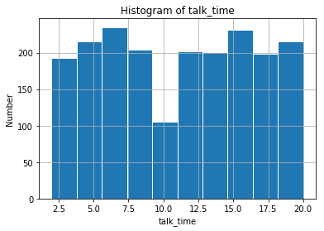
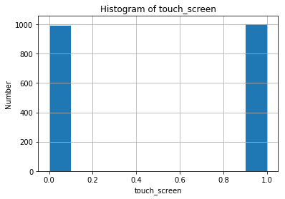
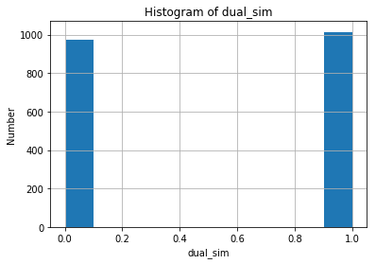
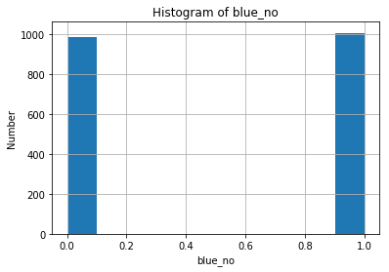

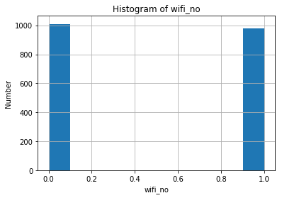
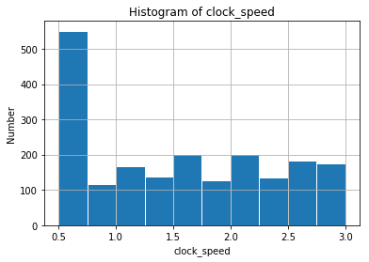
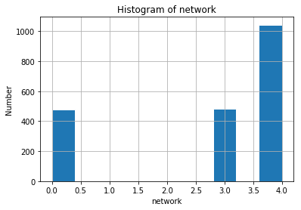
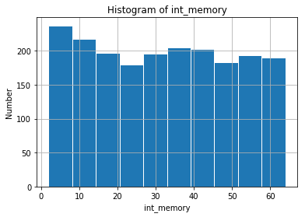
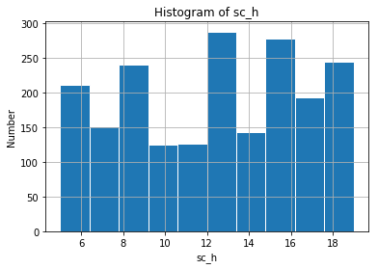
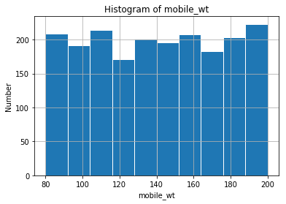
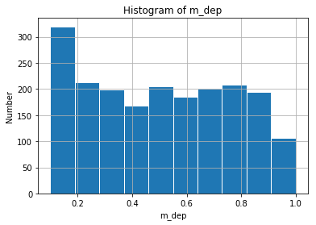
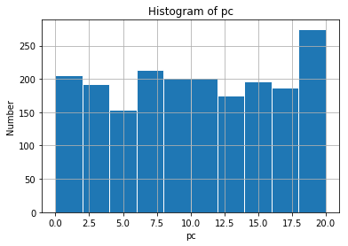
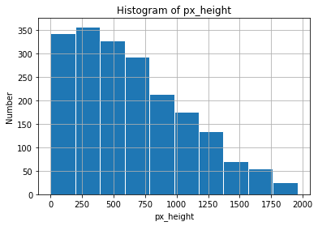
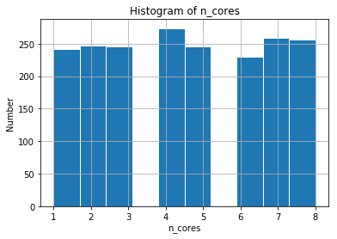
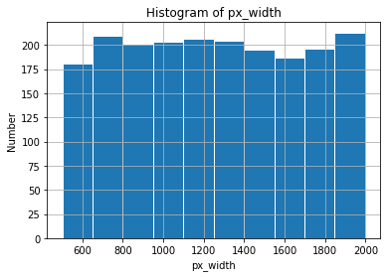
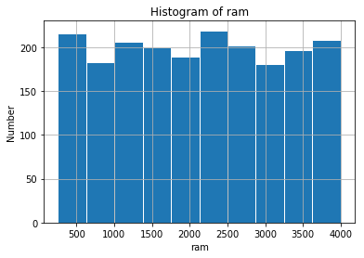
Visualization of Remaining Variable Univariate Analysis
Notes:
Use matplotlib to draw the histgram

Slide 15
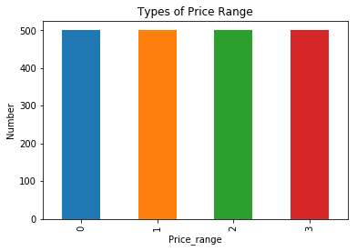
Univariate Variable Analysis- Target Variable
pandas.value_counts()
Notes:
Bar chart and pie chart

Slide 16
Pair-Wise Relationship
We see there are moderate correlation between "px_width" and "px_height", "sc_w" and "sc_h".

Slide 17
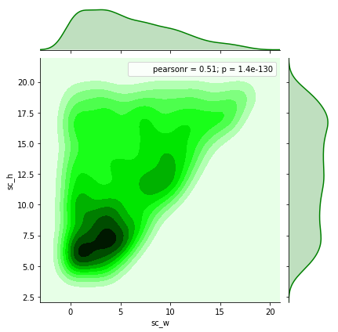
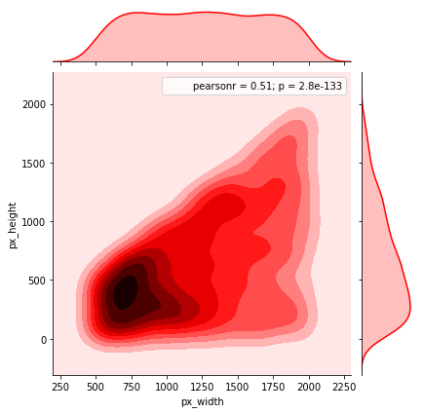
Pair-Wise Relation
2) The distribution between 'px_width' and 'px_height'
3)The distribution between "sc_w" and "sc_h"
Jointplot

Slide 18
Pair-Wise Relationship
We can also clearly find the "ram", "battery_power" are most correlated to our target variable- "price_range".

Slide 19
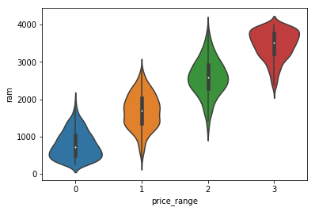
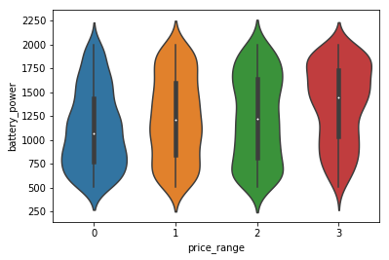
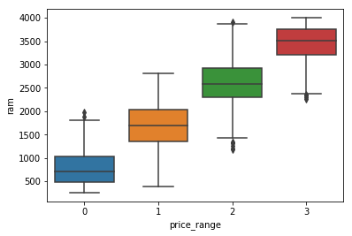
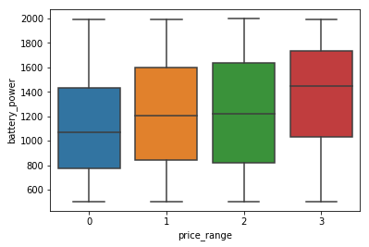
Pair-Wise Relation-Violin Plot and Boxplot
How does price affected by the ram？
How does price affected by the battery power？
Notes:
he picture clearly shows for the lower price (price range=0), the ram of the most mobile phone is also small; for the higher price (price range = 3), the ram of the most phone is also large. From the boxplot, we can easily see the price range “0”, “2”, “3” have outliers, but not too much. Besides, we can get the ram in each price range are nearly normally distributed.

Slide 20
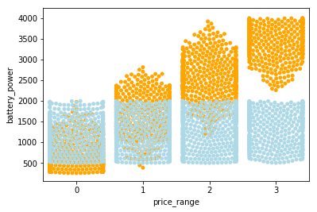
Indictors VS Target Value-Swarmplot
Orange: ram
Blue: battery_power

Slide 21

Models Data Pre-processing
Set X and Y
Get the training /testing dataset: 70% / 30%
Convert the data into the same scale: use ‘StandardScaler()’
Notes:
I chose 70% of data as training dataset and 30% of data as testing dataset randomly. The training dataset can help me make the predictions and the test dataset can help us check the accuracy of the model. Besides, I converted the data in to the same scale by using the ‘standardScaler()’ function which from scikit learn library.

Slide 22
Models-Machine Learning Part Naive Bayes (Gaussian Naive Bayes algorithm )
GaussianNB module
‘fit()’ function
‘predict()’
Accuracy, precision, recall, f1 scores
Notes:
Firstly, I used Naïve Bayes classifier which assume each feature are independent. Here, I used the Gaussian Naive Bayes algorithm since the features have continuous values.
I used the GaussianNB module from sklearn library to built the Gaussian Naive Bayes classifier. I use the ‘fit()’ function to train it. Then, I used the ‘predict()’ function to test the model. Thereafter, I compute the accuracy of the Naive Bayes model by compare the prediction with the target value which in the test dataset. I also evaluate the performance of a model

Slide 23
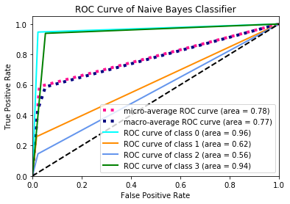
Naive Bayes (Gaussian Naive Bayes algorithm )-Results
 | Class 0 | Class 1 | Class 2 | Class 3
Accuracy | 93.38 | 71.85 | 71.52 | 92.02
Precision Score | 93.38 | 74.05 | 72.48 | 88.76
Recall Score | 93.38 | 71.85 | 71.52 | 92.02
F1-Score | 93.38 | 72.93 | 72.00 | 90.36
Note: Binarize the output: set label_binarize()
Notes:
I found the Naïve Bayes model show the great performance on the price range 1.
In order to make the ROC curve, I set the ‘label_binarize()’ function to binarize the output in the main script. Then, I use the OneVsRestClassifier to predict each class against other. In addition, I compute ROC curve and ROC area for each class, micro-average ROC curve and ROC area, macro-average ROC curve and ROC area. Finally, I got my ROC curve for the Naïve Bayes Classifier.

Slide 24
Other Models Building (Support Vector Machine (SVM), Decision Tree
LinearSVC module, DecisionTreeClassifier
‘fit()’ function
‘predict()’
Accuracy, precision, recall, f1 scores

Slide 25

Results for Other Models (SVM, Decision Tree)
SVM
Decision Tree
 | Class 0 | Class 1 | Class 2 | Class 3
Accuracy | 100 | 72.59 | 72.85 | 99.39
Precision Score | 94.97 | 73.13 | 78.57 | 97.01
Recall Score | 100 | 72.59 | 72.85 | 99.39
F1-Score | 97.42 | 72.86 | 75.76 | 98.18
 | Class 0 | Class 1 | Class 2 | Class 3
Accuracy | 82.12 | 71.85 | 60.26 | 79.14
Precision Score | 87.32 | 61.39 | 62.76 | 83.23
Recall Score | 82.12 | 71.85 | 60.26 | 79.14
F1-Score | 84.64 | 66.21 | 61.49 | 81.13
SVM classifier has the better performance on price range 0 and price range 3.
Decision Tree classifier has the better performance on price range 0 and price range 3 compare to other price range。

Slide 26

Neural Network Part— Multilayer Perceptron
Parameters:
Net Architecture:
BATCH_SIZE = 50
NUM_EPOCHS = 2000
LEARNING_RATE = 0.005
HIDDEN_NODE = 100
SEED_START = 10
LOSS_TARGET = 0.01
SEED_STEP = 5
Notes:
Forward step:
Propagate activation
from input to output layer
Backward step:
propagate errors from output to hidden layer

Slide 27
Performance of Multilayer Perceptron
 | Class 0 | Class 1 | Class 2 | Class 3
Accuracy | 95 | 88 | 88 | 94
Precision Score | 94.12 | 88015 | 89.26 | 94.48
Recall Score | 95.36 | 88.15 | 88.08 | 94.48
F1-Score | 94.74 | 88.15 | 88.67 | 94.48
All index bigger than 80% which is good

Slide 28

Models Comparison
The performance of MLP is better than other models, and every indictor for MLP is bigger than 90%

Slide 29

Conclusion
We see there are store correlation between "fc" and "pc” and there are moderate correlation between "px_width" and "px_height", "sc_w" and "sc_h".
We can also clearly find the "ram", "battery_power” are most related to our target variable- "price_range".
3） MLP is the best model to predict price range of mobile phone.

Slide 30

Thank You
End…. Questions?

Slide 31
Reference
https://www.financialexpress.com/industry/gst-impact-on-mobile-phone-after-apple-iphone-asus-zenfone-3-zenfone-3-max-prices-cut-by-as-much-as-rs-3000-check-new-rates/745444/
https://www.xcite.com/phones/mobile-phones.html
https://www.mprc.co/mobile-phone-price-list/
https://www.kaggle.com/iabhishekofficial/mobile-price-classification

